Slide 1
Student Engagement in Science and User-Centered Engineering: Educational Designs with Young Adolescents in an Invention Camp and Classroom Unit
Mr. David W. Jackson, Boston College
Dissertation Defense
May 2, 2022
Dr. G. Michael “Mike” Barnett, Chair; Dr. Nathaniel J. S. Brown, Reader; Dr. Helen Zhang, Reader
This work was supported by a Collaborative Fellows grant, from the Boston College Lynch School of Education and Human Development.

Slide 2
Overview of Presentation
0. Introduction
1. Paper 1: in-school-time
2. Paper 2: out-of-school-time
3. NOT-Paper 3: cross-case comparison
4. Discussion
5. Appreciations + Q&A

Slide 3
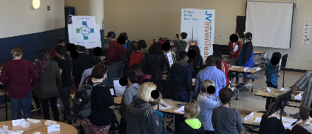
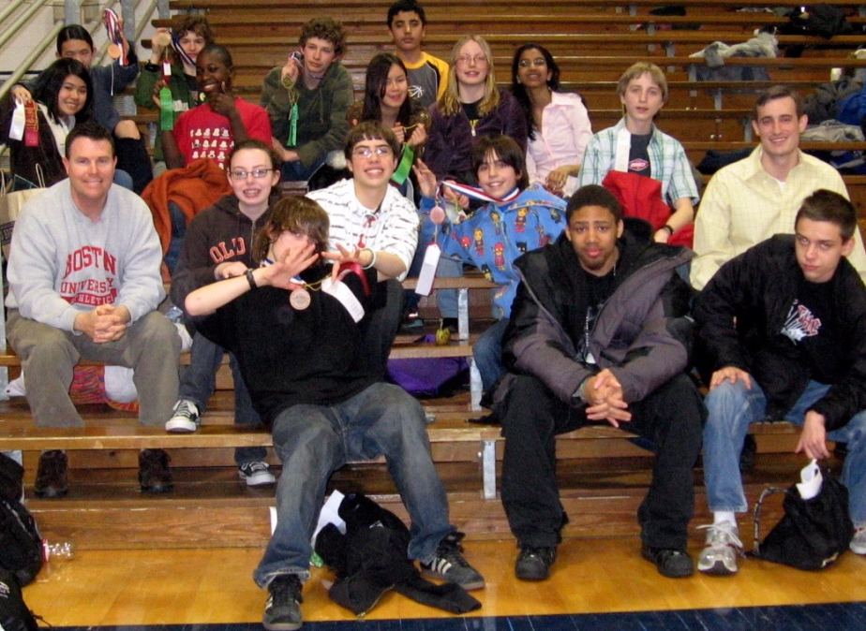
0.1: Positionality
Dialectics as core to my identity (Johnson, 2017; Onwuegbuzie & Frels, 2013)
Learning scientist (Yoon & Hmelo-Silver, 2017)
student engagement as “magic” (also central); equality → equity
☯️
Notes:
First, I will situate myself in this work. From 1981-1999 I was born and raised through grades K-12 in suburban areas of New York City and Houston, in predominantly white and upper-middle class communities. I enjoyed competitions, both individual- and team-based. In these competitions, it was very important to me that everyone had what I perceived to be an equal chance, with rules equally enforced. <click> This first picture clearly shows a young researcher, observing teammates holding a Connecticut state championship trophy for soccer.
For grades 13-20, interspersed with 10 years teaching during the school day, I have lived in urban and semi-urban areas, more heterogeneous in terms of race and ethnicity, socioeconomic class, and cultural and linguistic backgrounds. My early years in middle-grades education still had a focus on equality and competition. <click> Here we see a young-ish practitioner, with a Science Olympiad team co-founded with a mentor who helped me survived my first four years of teaching, Mr. Billy McDonald.
For 10-and-a-half of the last 12 years, I have lived ***VERY close*** to what I call “Mills City”… perhaps as close as possible. #PlausibleAnonymity In this time, my work has shifted from more competition- to community-oriented, or perhaps a combination that Hutter and colleagues call “communitition”. Also, my focus on equality has trended towards equity, or what Amy Sun of everydayfeminism.com calls “giving everyone what they need to be successful”. <click> Here we see photos from two February Vacation Camps, including one team and a community Showcase.
In sum, I consider dialectics to be core to my identity – logics of urban and suburban living; majoritized and minoritized ways of being, thinking, and doing; and the deeper understandings and more equitable learning designs that we can create, if we take “both/and” approaches to research, making sure to prioritize historically minoritized voices. <click>
As a researcher, I identify as a learning scientist, considering ALL sciences – social, natural, educational, economic, etc. – when studying learning. I am an engineer who was one class from a poetry minor; a science teacher who also led Literacy Workshops; and a consistent member of interdisciplinary teams that included members with expertise in science education, language-learning, psychometrics, entrepreneurship, inventiveness, career development, life purpose, and more.
Finally, as a practitioner and researcher, student engagement has always been “magic” for me – and, fortunately, I am not alone in that stance, as it is central to theories of motivation, flow, and self-determination. And though the field of student engagement has some problematic roots in equality-based approaches, I view my work as part of a shift in the field towards more equitable approaches.

Slide 4
0.2: Rationale: Research Problem
Young adolescence as sensitive period (Santrock, 2007)…
…esp. for those minoritized in STEM (Tytler & Osborne, 2012)
User-centered design, especially inventing, shows potential out-of-school-time (OST) (Invention Education Research Group, 2019)…
…but not much evidence in-school-time (IST)
Student engagement as central… (Christenson et al., 2012)
…yet with “slipperiness” (Olitsky & Milne, 2012)
So, let’s study engagement IST and IST to better understand educational design for equitable adolescent STEM participation

Slide 5
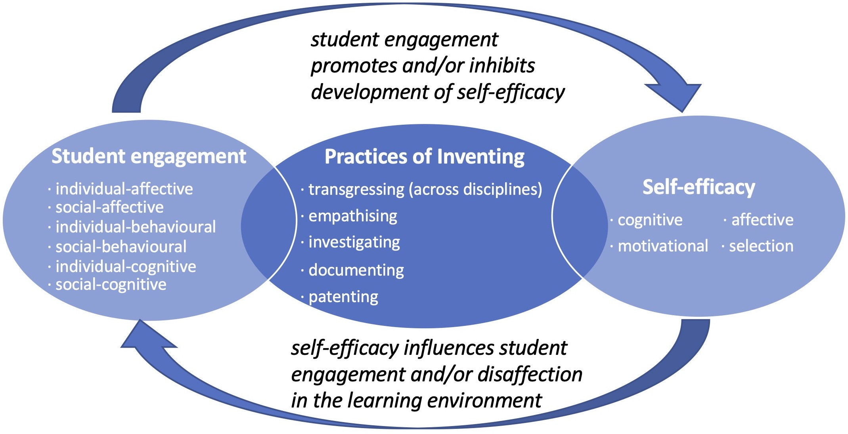
0.3: Conceptual Framework
Key concepts:
student engagement (abc|s)…
…in practices of sci./eng.
self-efficacy theory
educational design:
Social Infrastructure Framework
Types of Team Members
Fredricks et al. (2004, 2016); Christenson et al. (2012)
NRC (2012); NGSS Lead States (2013); Rodriguez (2015); Norman (2005, 2013, 2020)
Bandura (1977, 1993, 2006); Schunk & DiBenedetto (2016); Schunk & Mullen (2012)
Bielaczyc (2006, 2013); Massachusetts Institute of Technology (2016)

Slide 6
0.4: Research Questions for the Entire Dissertation
Overall | What are some educational design considerations for promoting student engagement, alongside development of self-efficacy, with young adolescents in practices of science and user-centered engineering?
Paper 1
Paper 2
Paper 3

Slide 7
0.4: Research Questions for the Entire Dissertation
Overall | What are some educational design considerations for promoting student engagement, alongside development of self-efficacy, with young adolescents in practices of science and user-centered engineering?
Paper 1 | Q1.1: engagement (descriptive) Q1.2: engagement <-> self-efficacy Q1.3: engagement <-> educational design
Paper 2
Paper 3

Slide 8
0.4: Research Questions for the Entire Dissertation
Overall | What are some educational design considerations for promoting student engagement, alongside development of self-efficacy, with young adolescents in practices of science and user-centered engineering?
Paper 1 | Q1.1: engagement (descriptive) Q1.2: engagement <-> self-efficacy Q1.3: engagement <-> educational design
Paper 2 | <same as Paper 1, but for OST>
Paper 3

Slide 9
0.4: Research Questions for the Entire Dissertation
Overall | What are some educational design considerations for promoting student engagement, alongside development of self-efficacy, with young adolescents in practices of science and user-centered engineering?
Paper 1 | Q1.1: engagement (descriptive) Q1.2: engagement <-> self-efficacy Q1.3: engagement <-> educational design
Paper 2 | <same as Paper 1, but for OST>
Paper 3 | Q3.1: ed. design <-> engagement <-> self-efficacy Q3.2: ed. design IST ≠ ed. design OST Q3.3: ed. design IST = ed. design IST

Slide 10
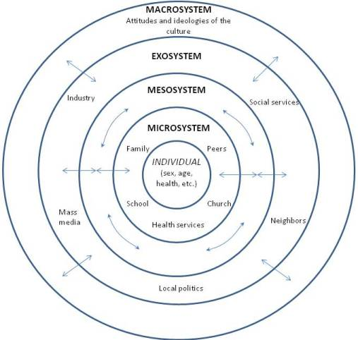
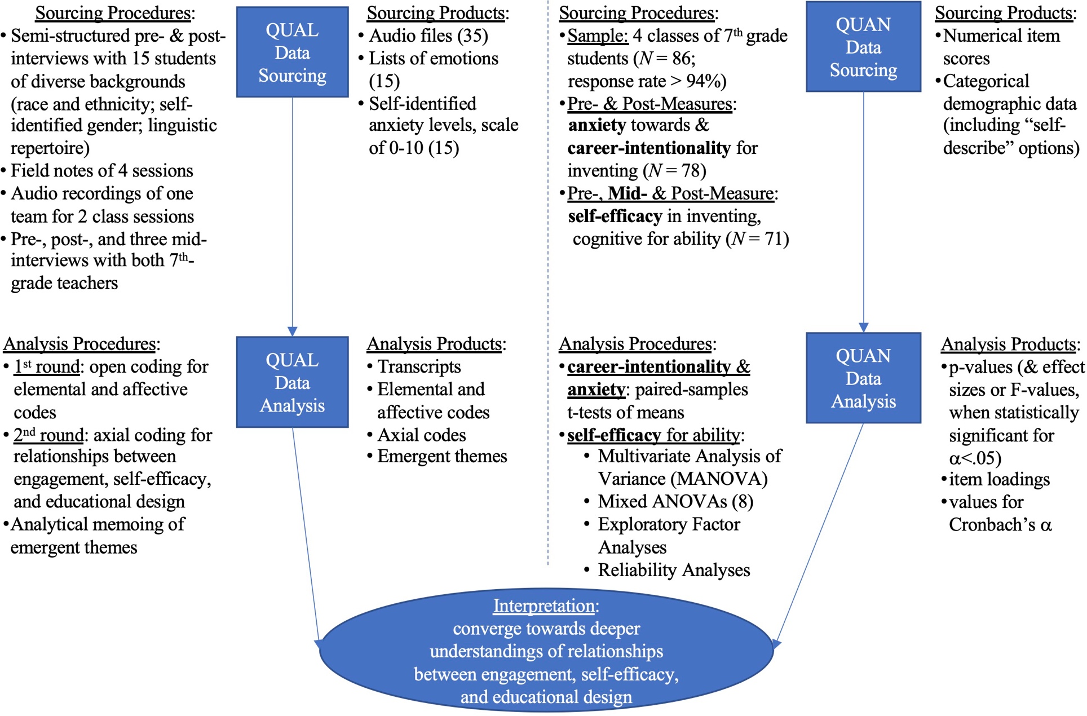
0.5: Methodology
Design-based research, cultural psychology approach (Bell, 2004)
individual|social dialectic
microculture, within broader contexts (Bronfenbrenner, 1993)
Mixed research, convergent designs (Creswell & Plano Clark, 2018)

Slide 11
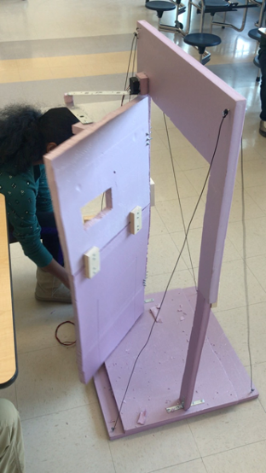
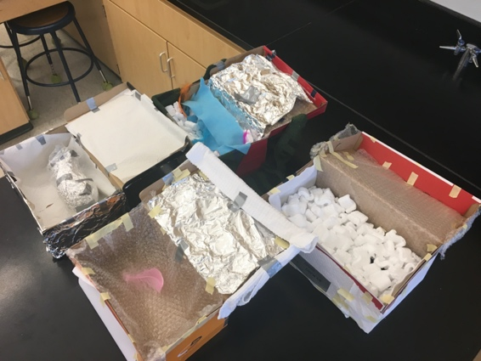
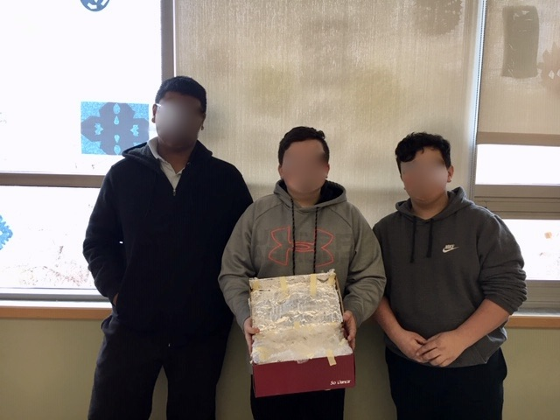
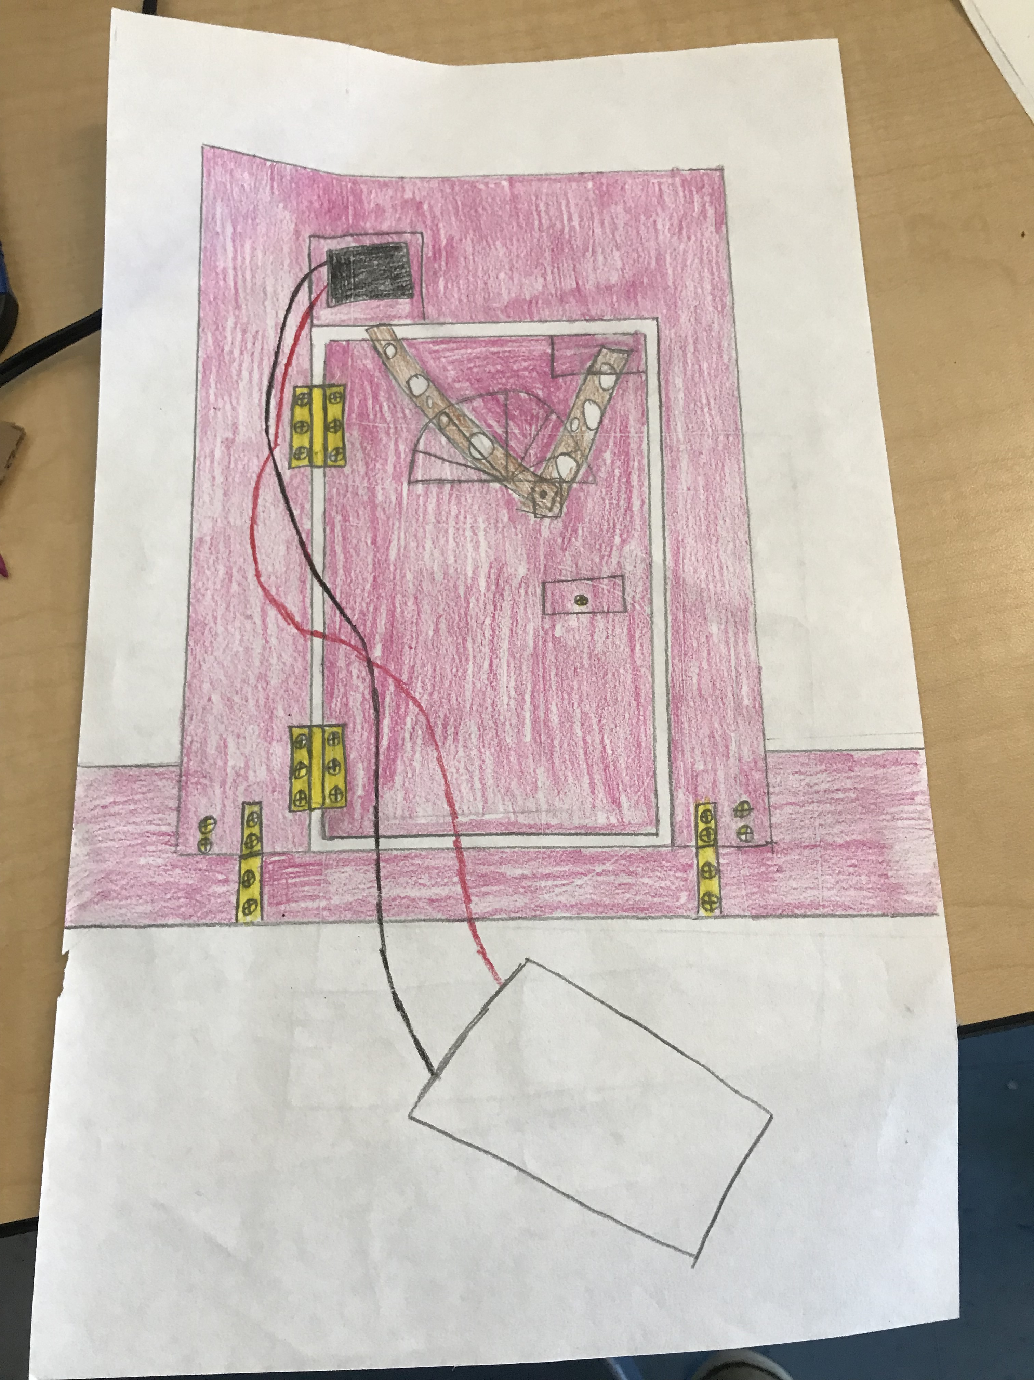
0.6 Methods: Settings, Participants, & Research Designs
IST class Northwest M.S. Gr. 7 sci. > des. insulating device t-tests of means
OST camp Central M.S. Gr. 6-8 des. > sci. electronic door multilevel modeling
Mills City ~20-25 hr. T.o.L. adult (co-)facil. inventing posters ANOVAs QUAL sourcing & analysis

Slide 12
1.0: Paper 1, Title and Target Journal
“Energetic, but also relaxed”: Social and Affective Engagement in a Grade-seven Insulating-device Project

Slide 13
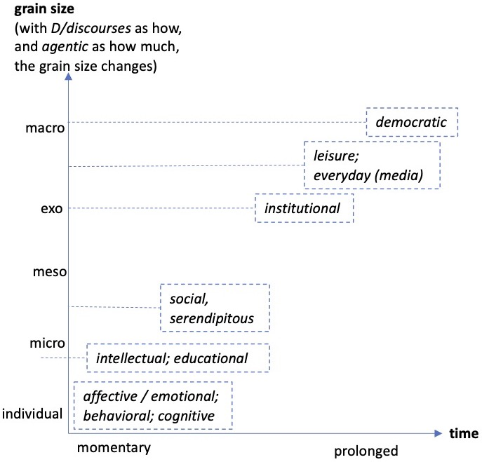
1.1: Paper 1, Literature Review (concise)
engagement as a concept (vs. theories of motivation)
affective/emotional, behavioral, cognitive
(and sometimes social)

Slide 14
1.2: Paper 1, Selected Findings + Implications
Findings
student engagement
affective: “energetic, but also relaxed” –Jay
behavioral: “[Inventing] is not my thing… But I do like the experience of [working on the insulating device].” -Paz
cognitive: “…maybe I should provide multiple gateways of doing this [summative assessment].” –Ms. Kumar
Implications
…learning activities: personalized beneficiaries + differentiated assessments
…learning and knowledge: “communitition” (Hutter et al., 2011)

Slide 15
2.0: Paper 2, Title and Target Journal
‘Magic’ or ‘maybe ... other years’: Designing for Young Adolescents' Engagement and Self-efficacy in an Invention Camp

Slide 16
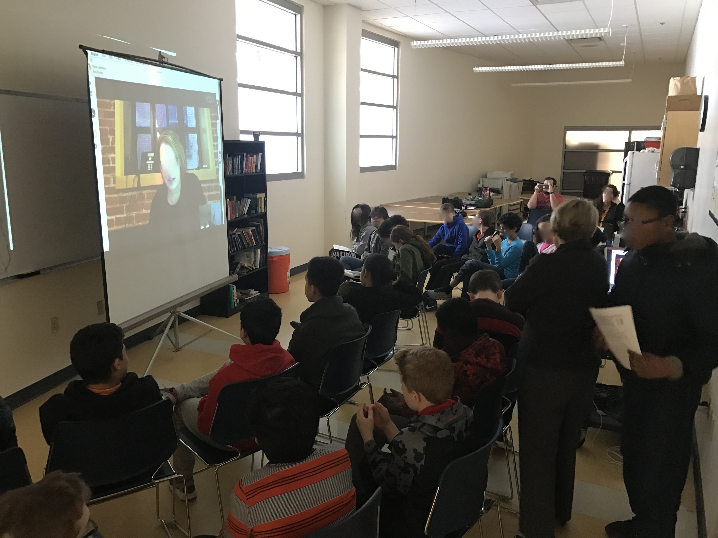
2.1: Paper 2, Literature Review (concise)
engagement as a threshold (McKinnon & Vos, 2015; Meyer & Land, 2003)
more formal:
peer-peer
educator-youth
more casual:
near-peer
professional-youth

Slide 17
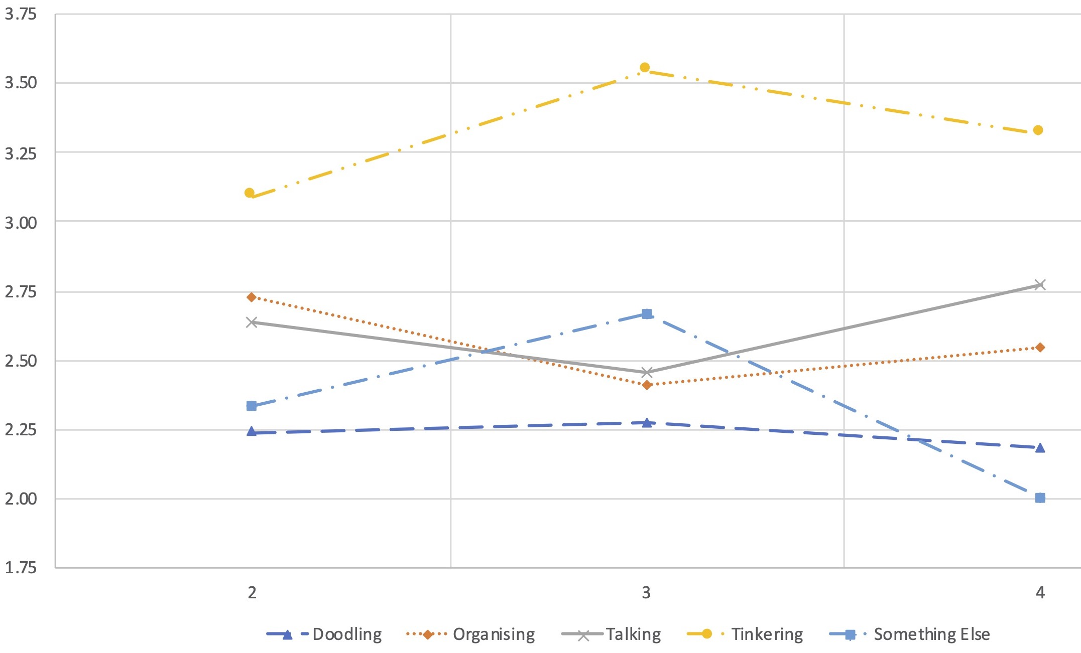
2.2: Paper 2, Selected Findings + Implications
Findings
QUAN: for self-efficacy, changes in close levels, but not proximal nor distal (Ruiz-Primo et al., 2002)
QUAL: for engagement, (un)fluidity → (in)equity
Team 1: ‘hablar más’, ‘maybe to the other years’
Team 2: ‘gods’ and ‘magic’
Implications
focus on practices, not roles (e.g., Tinkerer → Tinkering)
emphasize practices as ‘overlapping waves’ (Siegler, 1996)

Slide 18
3.0: Paper 3, Title and Target Journal
Inventors Emerging In- and Out-of-School:
Five Years of Adolescent Student Engagement in Classes and Camps
→ omitted for time & overlap with Section 4

Slide 19
4.0: Discussion of the Three-Paper Set
Integrated Findings +
Contributions to the Fields …
(+ Future Directions & Closing Remarks)

Slide 20
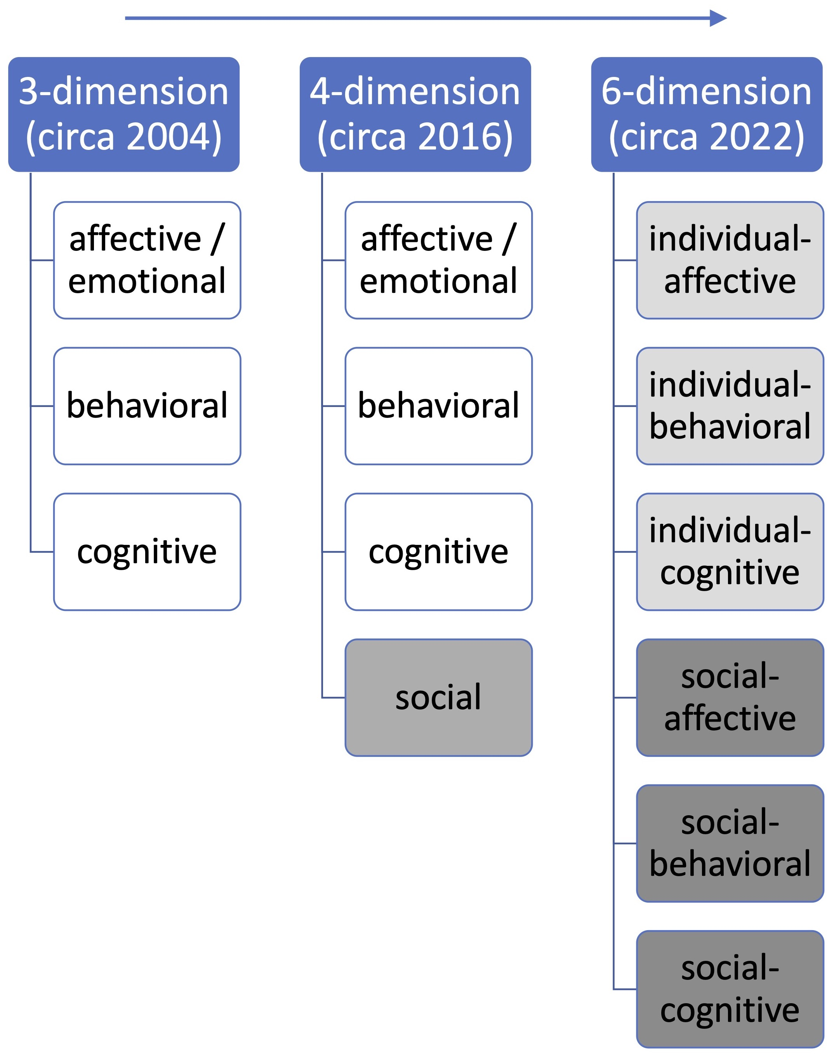
4.1.1: Integrated Findings: Engagement ( / Engaging)
 | individual | social
affective / emotional | Excitement to make an electronic door for his pet birds | Excitement for successes of teammates (e.g., wiring)
behavioral | Using screws and brackets to fasten door frame to base board (alone) | Working with teammates to have one person hold parts while the other person fastens the parts
cognitive | Awareness of which tasks needed to be done (list of requirements) | Awareness of how the tasks were shared amongst teammates (distribution of requirements)

Slide 21
4.1.2 & 4.1.3: Integrated Findings: Self-Efficacy & Educational Design
self-efficacy
ability: emotive and enactive sources (e.g., near-peer & “professional”)
anxiety: → counterbalancing dynamics (individual | social)
educational design
how a student’s social identity is understood: young, amateur, socially interdependent
planned learning activities: balance, fluidity

Slide 22
4.2: Contributions to the fields of…
…student engagement
4-dimension → 6-dimension
ed. psych. → learning sciences
…self-efficacy theory
…educational design (esp. Social Infrastructure Framework)
implementation paths, incl. participatory IST<->OST
expanding what counts as “the outside world”
dominant narratives: | pre-/post- | IST only | Western / Global North… | cog./soc. psych.
dominant narratives: | pre-/post- | IST only | Western / Global North… | cog./soc. psych.
counter-narrative: | pre-/post-/mid- | IST and OST | …+ Eastern / Global South | learning sciences

Slide 23
4.3: Future Directions
empirical
new measurement suites
# of roles > # of teammates
CHAT-based (Cultural-Historical Activity Theory; Gutiérrez et al., 1999)
conceptual:
expansion of “environmental” factors
differentiation between social and collective
policy
local: invention ed. as elective or capstone (at least)
(nation)-state: inventing as social-emotional (incl. accountability)

Slide 24
4.4: Closing Remarks
Thank you for learning with me these past 5+ years!
☯️

Slide 25
5. References + Feedback
Allen, A., Ball, M., Bild, D., Boone, D. N., Briggs, D., Davis, D., & De, L. (2020). Leveraging out-of-school STEM programs during COVID-19. Connected Science Learning, 2(4).
Bandura, A. (1977). Self-efficacy: Toward a unifying theory of behavioral change. Psychological Review, 84(2), 191–215. https://doi.org/10.1037/0033-295X.84.2.191
Bandura, A. (1993). Perceived self-efficacy in cognitive development and functioning. Educational Psychologist, 28(2), 117–148.
Bandura, A. (2006). Guide for constructing self-efficacy scales. In Self-efficacy beliefs of adolescents (pp. 307–337). Information Age Publishing. https://doi.org/10.1017/CBO9781107415324.004
Bell, P. (2004). On the theoretical breadth of design-based research in education. Educational Psychologist, 39(4), 243–253. https://doi.org/10.1207/s15326985ep3904_6
Bevan, B., Dillon, J., Hein, G. E. E., Macdonald, M., Michalchik, V., Miller, D., Root, D., Rudder, L., Xanthoudaki, M., & Yoon, S. (2010). Making Science Matter: Collaborations Between Informal Science Education Organizations and Schools. A CAISE Inquiry Group Report. Center for Advancement of Informal Science Education (CAISE).
Bielaczyc, K. (2006). Designing social infrastructure: Critical issues in creating learning environments with technology. Journal of the Learning Sciences, 15(3), 301–329.
Bielaczyc, K. (2013). Informing design research: Learning from teachers’ designs of social infrastructure. Journal of the Learning Sciences, 22(2), 258–311.
Bronfenbrenner, U. (1993). Ecological models of human development. In M. Gauvain & M. Cole (Eds.), Readings on the Development of Children (2nd ed., pp. 37–43). Freeman.
Cheeptham, N., Mahara, S., Antoine, M., Insuk, C., & Loy, K. (2020). Aboriginal youth summer camp in science and health science: A Western Canadian university review of 10 years of successes and learning. International Journal of Science Education, Part B: Communication and Public Engagement, 0(0), 1–13. https://doi.org/10.1080/21548455.2020.1748743
Cho, S., Crenshaw, K. W., & McCall, L. (2013). Toward a field of intersectionality studies: Theory, applications, and praxis. Signs: Journal of Women in Culture and Society, 38(4), 785–810.
Christenson, S. L., Wylie, C., & Reschly, A. L. (2012). Handbook of Research on Student Engagement. doi.org/10.1007/978-1-4614-2018-7 & https://www.researchgate.net/profile/Azkananda-Widiasani/publication/310773130_Handbook_of_Student_Engagement/links/5836a0dd08aed45931c772b7/Handbook-of-Student-Engagement.pdf
Conner, J. O., & Pope, D. C. (2013). Not Just Robo-Students: Why Full Engagement Matters and How Schools Can Promote It. Journal of Youth and Adolescence, 42(9), 1426–1442.
Crenshaw, K. (1989). Demarginalizing the intersection of race and sex: A Black feminist critique of antidiscrimination doctrine, feminist theory and antiracist politics. The University of Chicago Legal Forum, 139–168.
Creswell, J. W., & Plano Clark, V. L. (2018). Designing and conducting mixed methods research (3rd ed.). SAGE.
Fredricks, J. A., Blumenfeld, P. C., & Paris, A. H. (2004). School engagement: Potential of the concept, state of the evidence. Review of Educational Research, 74(1), 59–109.
Fredricks, J. A., Hofkens, T., Wang, M. T., Mortenson, E., & Scott, P. (2018). Supporting girls’ and boys’ engagement in math and science learning: A mixed methods study. Journal of Research in Science Teaching, 55(2), 271–298. https://doi.org/10.1002/tea.21419
Fredricks, J. A., Wang, M. T., Linn, J. S., Hofkens, T. L., Sung, H., Parr, A., & Allerton, J. (2016). Using qualitative methods to develop a survey measure of math and science engagement. Learning and Instruction, 43, 5–15. https://doi.org/10.1016/j.learninstruc.2016.01.009
Gutiérrez, K. D., Baquedano‐López, P., & Tejeda, C. (1999). Rethinking diversity: Hybridity and hybrid language practices in the third space. Mind, Culture, and Activity, 6(4), 286–303.
Invention Education Research Group. (2019). Researching invention education. https://lemelson.mit.edu/sites/default/files/content/documents/LMIT-ResearchingInventEdu-WhitePaper-2.21.2020 copy.pdf
Johnson, R. B. (2017). Dialectical pluralism: A metaparadigm whose time has come. Journal of Mixed Methods Research, 11(2), 156–173. https://doi.org/10.1177/1558689815607692
Johnson, D. W., & Johnson, R. T. (2009). An educational psychology success story: Social interdependence theory and cooperative learning. Educational Researcher, 38(5), 365–379.
Maltese, A. V., & Tai, R. H. (2011). Pipeline persistence: Examining the association of educational experiences with earned degrees in STEM among U.S. students. Science Education, 95(5), 877–907.
Mangan, J. M., Newman, D., Doss, K. B., & Virani, S. N. (2019). Improving science content learning with choreographed songs at an astronomy summer camp. International Journal of Science Education, Part B: Communication and Public Engagement, 9(2), 101–113. https://doi.org/10.1080/21548455.2019.1571257
McKinnon, M., & Vos, J. (2015). Engagement as a Threshold Concept for Science Education and Science Communication. International Journal of Science Education, Part B: Communication and Public Engagement, 5(4), 297–318. https://doi.org/10.1080/21548455.2014.986770
Massachusetts Institute of Technology [MIT]. (2016). Chill Out: Educator guide. Lemelson-MIT JV InvenTeams Program. https://lemelson.mit.edu/curriculum-invention/jv-inventeams-chill-out
Meyer, J. H. F., & Land, R. (2005). Threshold concepts and troublesome knowledge (2): Epistemological considerations and a conceptual framework for teaching and learning. Higher Education, 49(3), 373–388. https://doi.org/10.1007/s10734-004-6779-5
National Research Council. (2012). A framework for K-12 science education: Practices, crosscutting concepts, and core ideas. National Academies Press.
NGSS Lead States. (2013). Next generation science standards: For states, by states. The National Academies Press.
Norman, D. (2020). Recycling: A poor solution to the wrong problem. https://jnd.org/recycling-a-poor-solution-to-the-wrong-problem/
Norman, D. A. (2013). The design of everyday things (Revised and expanded). Basic Books.
Norman, Donald A. (2005). Human-centered design considered harmful. Interactions, 12(4), 14–19. https://doi.org/10.1145/1070960.1070976
Olitsky, S., & Milne, C. (2012). Understanding engagement in science education: The psychological and the social. In B. J. Fraser, K. G. Tobin, & C. J. McRobbie (Eds.), Second International Handbook of Science Education (pp. 19–33). Springer. https://doi.org/10.1007/978-1-4020-9041-7_2
Onwuegbuzie, A. J., & Frels, R. K. (2013). Toward a new research philosophy for addressing social justice issues: Critical dialectical pluralism 1.0. International Journal of Multiple Research Approaches, 7(1), 9–26. https://doi.org/10.5172/mra.2013.7.1.9
Riedinger, K., & McGinnis, J. R. (2017). An investigation of the role of learning conversations in youth’s authoring of science identities during an informal science camp. International Journal of Science Education, Part B: Communication and Public Engagement, 7(1), 76–102. https://doi.org/10.1080/21548455.2016.1173741
Rodriguez, A. J. (2015). What about a dimension of engagement, equity, and diversity practices? A critique of the Next Generation Science Standards. Journal of Research in Science Teaching, 52(7), 1031–1051. https://doi.org/10.1002/tea.21232
Ruiz-Primo, M. A., Shavelson, R. J., Hamilton, L., & Klein, S. (2002). On the evaluation of systemic science education reform: Searching for instructional sensitivity. Journal of Research in Science Teaching, 39(5), 369–393.
Santrock, J. W. (2007). Adolescence (11th ed.). McGraw-Hill.
Schunk, D. H., & DiBenedetto, M. K. (2016). Self-efficacy theory in education. In K. R. Wentzel & D. B. Miele (Eds.), Handbook of Motivation at School (2nd ed., pp. 34–54). Routledge.
Schunk, D. H., & Mullen, C. A. (2012). Self-efficacy as an engaged learner. In S. L. Christenson, C. Wylie, & A. L. Reschly (Eds.), Handbook of research on student engagement (pp. 219–235). Springer.
Sinatra, G. M., Heddy, B. C., & Lombardi, D. (2015). The challenges of defining and measuring student engagement in science. Educational Psychologist, 50(1), 1–13.
Stofer, K. A., Rujimora, J., Sblendorio, D., Duqueney, E., Tatineni, M., & Gaudier, G. (2019). Casual conversations in everyday spaces can promote high public engagement with science. International Journal of Science Education, Part B: Communication and Public Engagement, 9(4), 296–311. https://doi.org/10.1080/21548455.2019.1670882
Tytler, R., & Osborne, J. (2012). Student attitudes and aspirations towards science. In Barry J. Fraser, K. G. Tobin, & C. J. McRobbie (Eds.), Second international handbook of science education (pp. 597–625). Springer.
Wieselmann, J. R., Dare, E. A., Ring-Whalen, E. A., & Roehrig, G. H. (2020). “I just do what the boys tell me”: Exploring small group student interactions in an integrated STEM unit. Journal of Research in Science Teaching, 57(1), 112–144. https://doi.org/10.1002/tea.21587
* “Their” previous work:
* My support system (Jackson, 2022, pp. ii-iv; also first page of Extra Slides)
* Your feedback (committee first)?

Slide 26
Extra slides start here

Slide 27
My Support System: Dedication + Acknowledgements
Dedication
This work is dedicated to young adolescents, each and all, whose ascending (from Latin adolescere) generates hope and resistance as societies work to humanize each and all members; and to those who work and learn with young adolescents.
Acknowledgements
To my committee: your patience, flexibility, support, and timely feedback have been crucial in (re)shaping this dissertation as repeated waves of the COVID-19 pandemic changed the way we conduct design-based research.
Mike – you are so economical with your words, as you let your actions do the talking; you unwaveringly center youth voice; you make time for check-ins while honoring your family responsibilities; in brief, you set an example that an emerging scholar would do well to emulate, albeit impossible to replicate.
Nathaniel – after some sporadic interactions early in my PhD program, and a near-miss taking a class with you, I was so thankful that you agreed to join my committee, embracing the three-paper format and being steadfast that research questions should drive the methods (even when I got tempted to do the reverse).
Helen – you have supported me in all stages of design-based research processes for around a dozen iterations, and also shown patience with me texting or calling at times outside of typical work hours. You are such an integral part of the Innovation in Urban Science Education (IUSE) lab, and I cannot imagine where the lab or I would be without your contributions.
Kate – from the learning sciences class, independent study, Dissertation Seminar, random conversations, and targeted feedback, your generosity with your expertise is only exceeded by your humility and openness. You are a beacon of hope that academics can harmonize research, practice, and personal life.
To my other professional mentors, including Carla, Chuck, Ellie, and Mary – your mentorship has been invaluable these past five-plus years, and I hope to “pay it forward”.
To all past and present members of the IUSE lab, as well as our partners in the Lemelson-MIT Program – in particular Adam, Ahmad, Alejandra, Amie, Amy, Anne, Anu, Ariella, Avneet, Casandra, Chris A., Chris K., Dasha, Fahd, Helen, Joey, Kathy, Leigh, Liza, Megan, Meng, Mengyi, Mike, Nathan, Pablo, Paul M., Paul X., Priyanka, Qi, Qingwan, Rahul, Rajeev, Sarah, SoLim, Steph, Tony, Yan, and Yihong – many of you have become family, a word I do not use lightly. You have joined my wedding party, supported me through personal crises, worked as co-thinkers and co-authors, and so much more. I hope you appreciate your time in the lab as much as I have appreciated my time in it.
To my other friends and family – I appreciate your patience, especially with my more esoteric explorations. Your support has helped me (re-)focus my work countless times, and to remain accountable to broad and practical concerns. You have done so much to support me over the years, that to list it all would be longer than this dissertation. I always have loved you, and I always will love you.
To the AERA, NARST, and NELS writing groups – as communities of “accountabili-buddies”, you have inspired me to write so many times when I didn’t feel like it. You provided structure in a relatively unstructured time, and this journey would have been much bumpier without your support.
To Daft Punk, Erykah Badu, The Holydrug Couple, Igor Stravinsky, Janelle Monae, Jimi Hendrix, Kendrick Lamar, Marvin Gaye, Massive Attack, Maurice Ravel, St. Germain, and Stevie Wonder – your artistry helped me sustain hope and resistance through economic, health, and racial crises.
Work for this dissertation was primarily supported by a Collaborative Fellows grant from Boston College. I also acknowledge the Lemelson-MIT Program, the National Science Foundation, Waltham Public Schools, and a private foundation that wishes to remain anonymous, for their support of my labmates and me over the past five-plus years.
To participating youth and adults – this work is dedicated to you, and is impossible without you. Your openness, generosity, and flexibility were crucial in finding “win-win-win’s” amongst research, practice, and community.
Finalmente, a Jasmine, mi amiga, pareja, esposa, y compañera para siempre – esta obra, y la vida entera, sin duda son más gratificantes y humanizantes, en interacción con nuestro amor radical.

Slide 28
0.1: Positionality
Dialectics as core to my identity (Johnson, 2017; Onwuegbuzie & Frels, 2013)
Learning scientist (Yoon & Hmelo-Silver, 2017)
engagement as “magic” (also central); equality → equity
Central question: How can we design learning environments that support
student engagement in science and engineering,
particularly for young adolescents, in ways that forge
dynamic solidarities among historically minoritized and majoritized communities?
☯️

Slide 29
1.1: Paper 1, Literature Review (verbose)
engagement as a concept (vs. theories of motivation)
connections with interest
timescales, grain-sizes, and disciplines
affective/emotional, behavioral, cognitive (& sometimes social)
overall-school: no cog. without aff. (Conner & Pope, 2013)
discipline-based (science, & sometimes engineering or math)
Fredricks et al. (2004, 2016, 2018) 🧮
Schmidt et al. (2018, 2020) ⌚️
Wieselmann et al. (2020) 🦫

Slide 30
1.2: Paper 1, Context + Data Sourcing
Setting:
“Mills City”: “Northwest Middle School”
Grade 7 IST: “Mr. Braun” & “Ms. Kumar”
Intervention
19, 56-minute class periods
Shoebox-size insulating devices
goals: efficacy, and also efficiency + cooperation + creativity
Mix of science/design/writing + individual/cooperative
Project, poster, & report
Data sourcing
QUAL: pre- & post-interviews; field notes; audiovisual recordings
QUAN: pre-, mid-, & post-surveys
Data analysis
QUAL: (1) process, emotion, & in vivo coding; (2) pattern & axial coding
QUAN: analyses of variance (ANOVAs) + t-tests of means (also EFA & reliability)

Slide 31
1.3: Paper 1, Selected Findings + Implications (verbose)
Findings
student engagement
affective: “energetic, but also relaxed” –Jay
behavioral: “[Inventing] is not my thing… But I do like the experience of [working on the insulating device].” –Paz
cognitive: “…maybe I should provide multiple gateways of doing this [summative assessment].” –Ms. Kumar
self-efficacy: “We were struggling a lot, at the beginning. And we didn’t really, like, get it. But then we pulled through.” –Jimmy
sci. ⬆️ vs. eng. ⬆️ vs. inventing ↕️
ability ⬆️ vs. anxiety ↕️ vs. selection ⬇️
Implications
…learning activities: personalized beneficiaries + differentiated assessments
…learning and knowledge: competition vs. cooperation vs. communitition (Hutter et al., 2011)
…a student’s social identity: young, amateur inventors; social interdependence (Johnson & Johnson, 2009)

Slide 32
2.1: Paper 2, Literature Review (verbose)
engagement as a threshold (McKinnon & Vos, 2015; Meyer & Land, 2003)
IST-OST
self-efficacy
career intentionality
peer-peer & educator-youth
Mangan et al. (2019) 🪐
Riedinger & McGinnis (2017) 🗣
near-peer & professional-youth
Cheeptham et al. (2020) 🎓
Stofer et al. (2019) ☕️

Slide 33
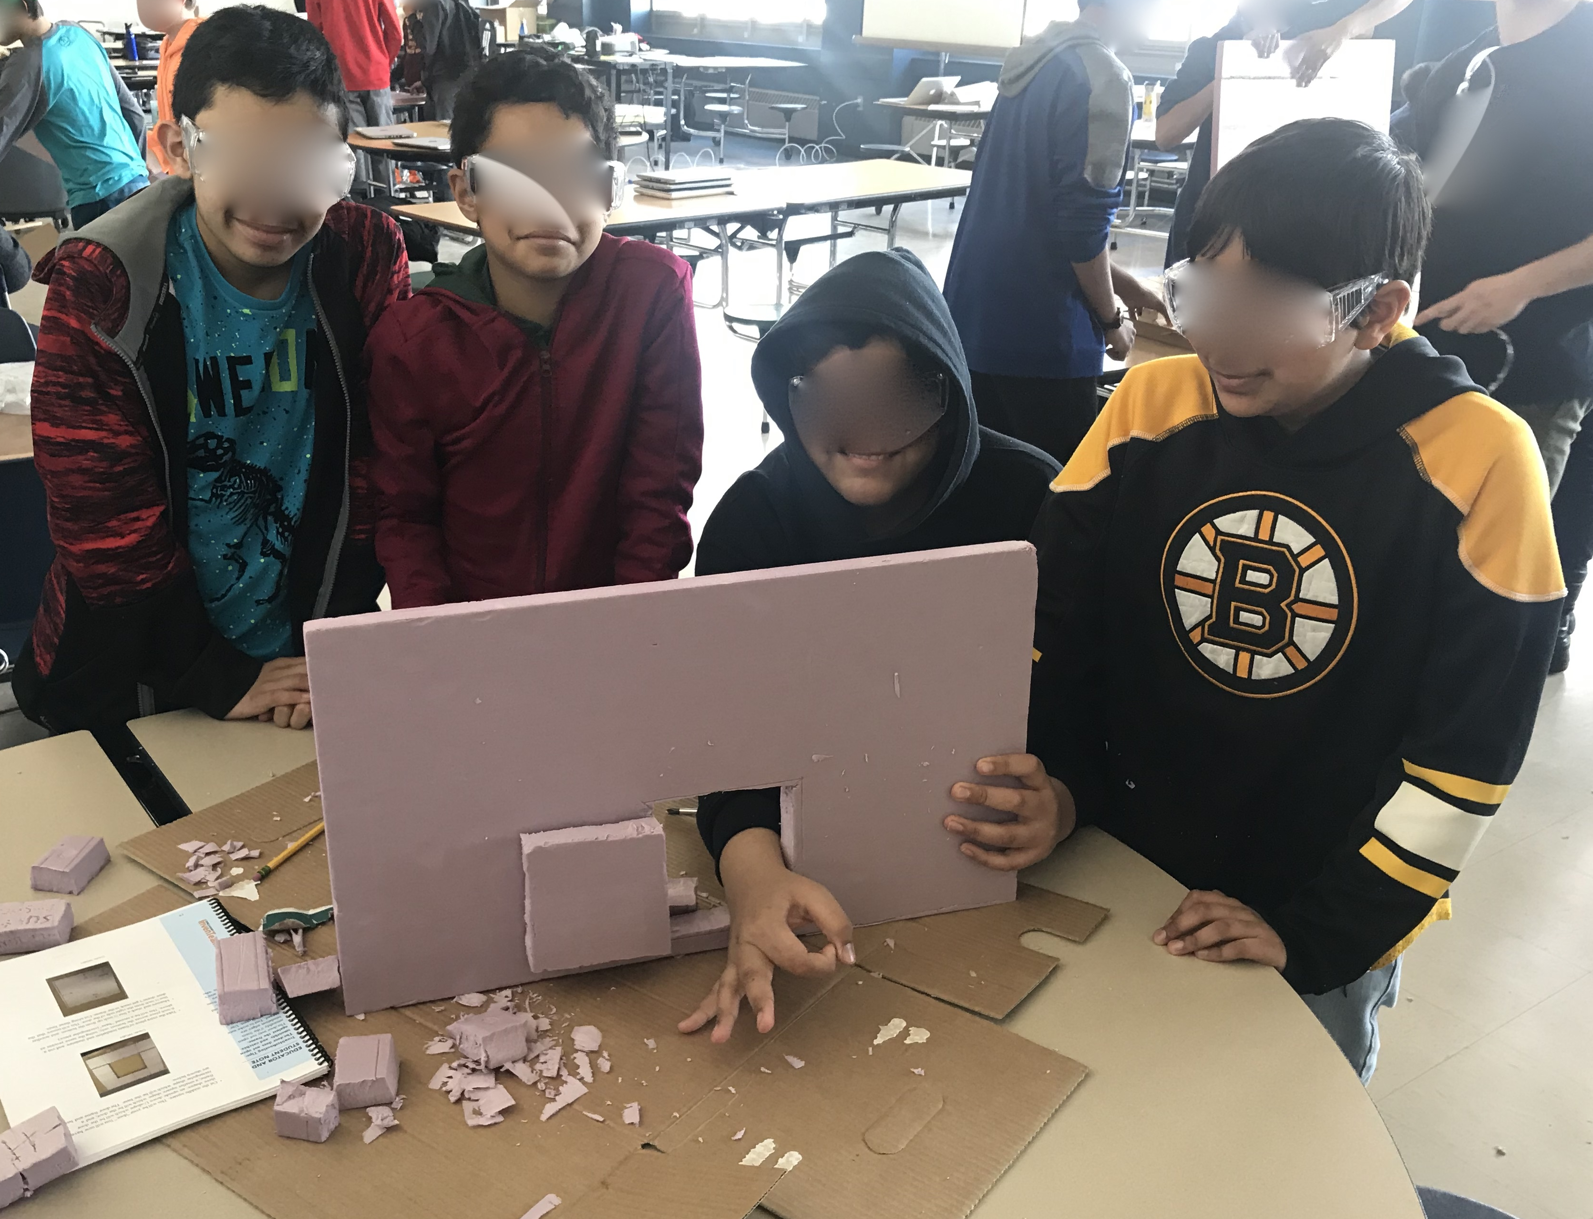
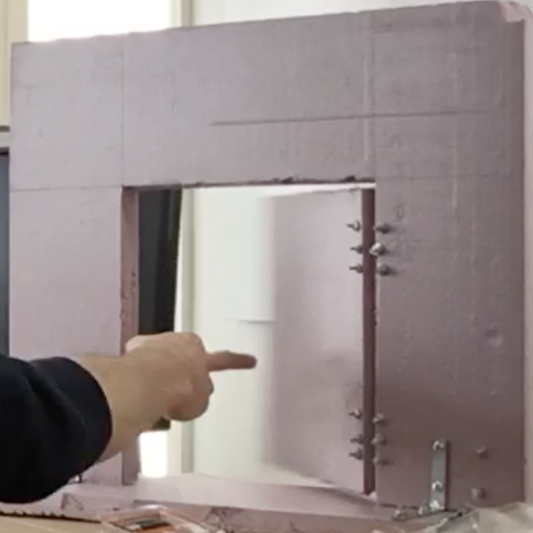
2.2: Paper 2, Context + Data Sourcing
Setting:
“Mills City”, “Central Middle School” (also incl. “NMS” students)
Grades 6-8 OST (camp)
Intervention
24 hours of time-on-learning (5-day total)
snake-, cat-, or toddler-size electronic doors
Mix of science/design + individual/cooperative
Project, poster/slideshow/video, & pamphlet
Data sourcing
QUAL: pre- & post-interviews; field notes; audiovisual recordings
QUAN: five daily “Exit Tickets” (eight, 7-point Likert items + several open-response items)
Data analysis
QUAL: (1) process, emotion, & in vivo coding; (2) pattern & axial coding
QUAN: analyses of variance (ANOVAs) for 100% of N=22; multilevel modeling for 83% of N=29

Slide 34
2.3: Paper 2, Selected Findings + Implications (verbose)
Findings
QUAN: for self-efficacy, changes in close levels, but not proximal nor distal (Ruiz-Primo et al., 2002)
QUAL: for engagement, (un)fluidity → (in)equity
Team 1: ‘hablar más’, ‘maybe to the other years’
Team 2: ‘gods’ and ‘magic’
QUAL+QUAN: differences in engagement and self-efficacy, at individual and social levels
Implications
focus on practices, not roles (e.g., Tinkerer → Tinkering)
ensure balance of roles (e.g., enough Doodling)
emphasize practices as ‘overlapping waves’ (Siegler, 1996)

Slide 35
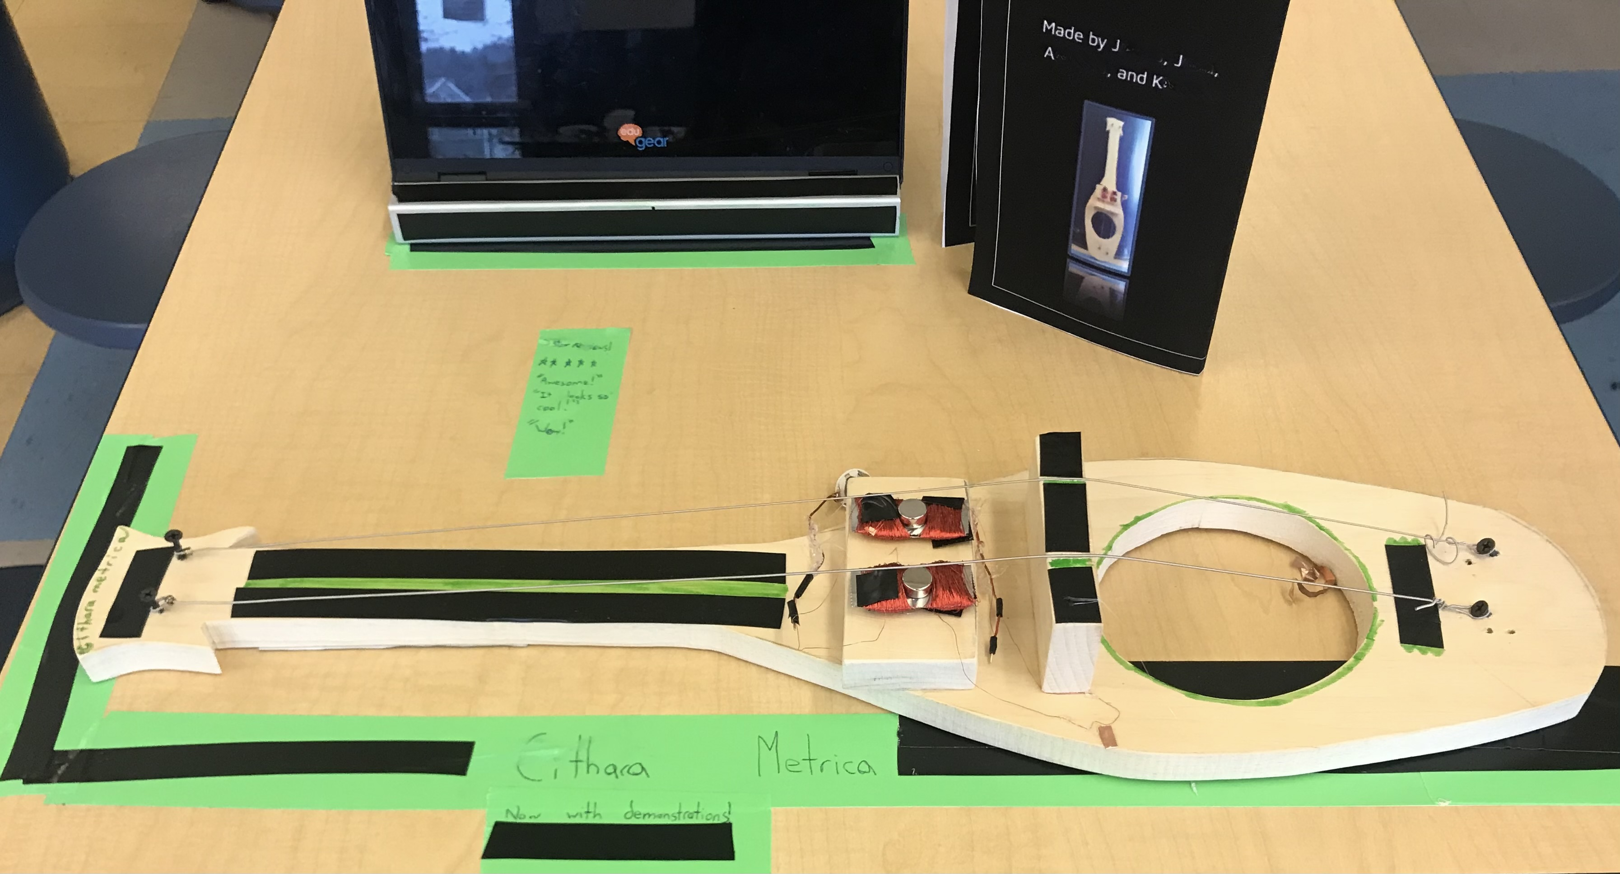
3.1: Paper 3, Literature Review (verbose)
RP: “co-designing formal, informal, and hybrid environments”
engagement as linking
communities, evaluators, policymakers, practitioners, researchers, youth, etc.
counter-narratives to IST = behavioral & cognitive / OST = affective & social
inventing as…
…interdisciplinary
…meaningful
…project-based
designing for IST, OST, and hybrid
synergy and sustainability (Bevan et al., 2010)
pandemic resiliency (Allen et al., 2020)

Slide 36
3.3: Paper 3, Selected Findings + Implications (verbose)
Findings: Successes / Challenges
successes
engagement: increased OST (vs. IST)
self-efficacy: ability → current performance accomplishments; anxiety → verbal persuasion (Bandura, 1977)
educational design: accessibility; meaningfulness
challenges
engagement: gender identity & gendered roles
self-efficacy: ability → prior performance accomplishments
educational design: fluidity of roles
“Implications and Future Plans”
engagement: six-dimensional lens; IST/OST counter-narratives
measurement: increase response scale and gradations of challenge (Bandura, 2006)
relevance: sustainability (Green Chemistry) + playful computing (Toy Design) <more info here>

Slide 37
4.4: Closing Remarks
student engagement: individual | social
self-efficacy theory: West/North | East/South (global)
educational design: classroom | “outside world”
settings: IST | OST
publications: research | practice
…for
Thank you for learning with me these past 5+ years!

Slide 39
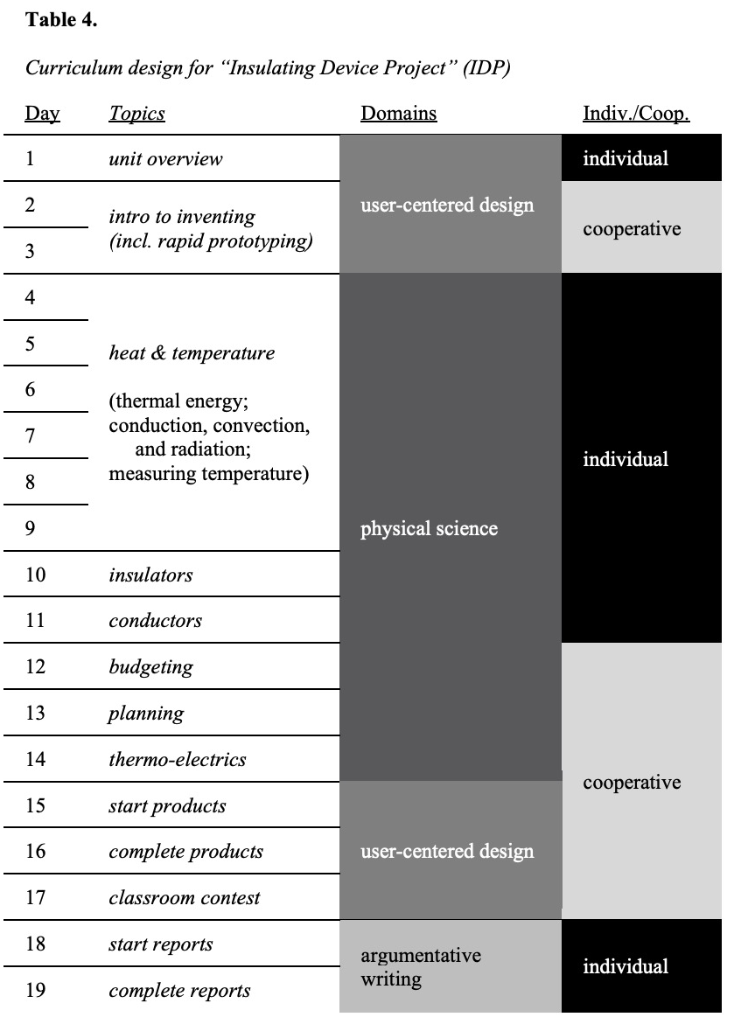
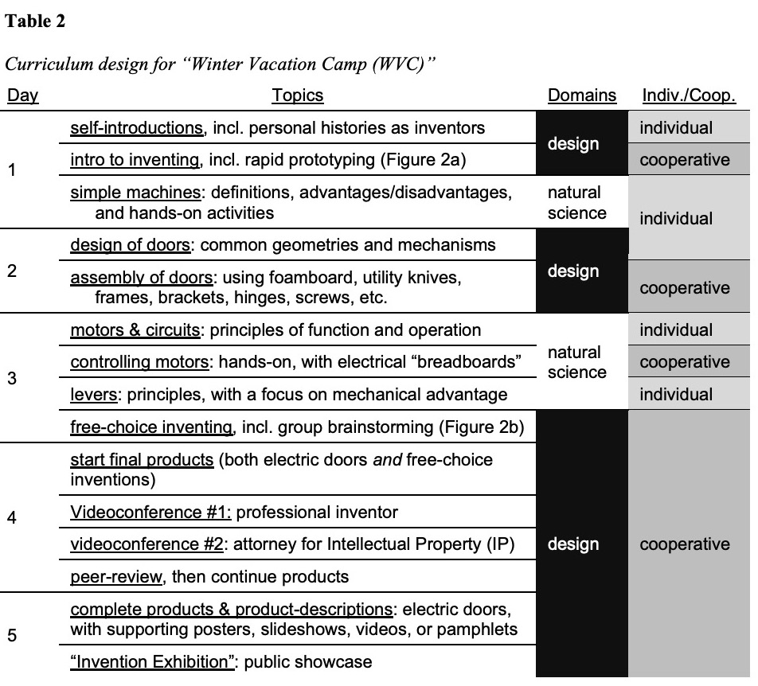

Slide 40
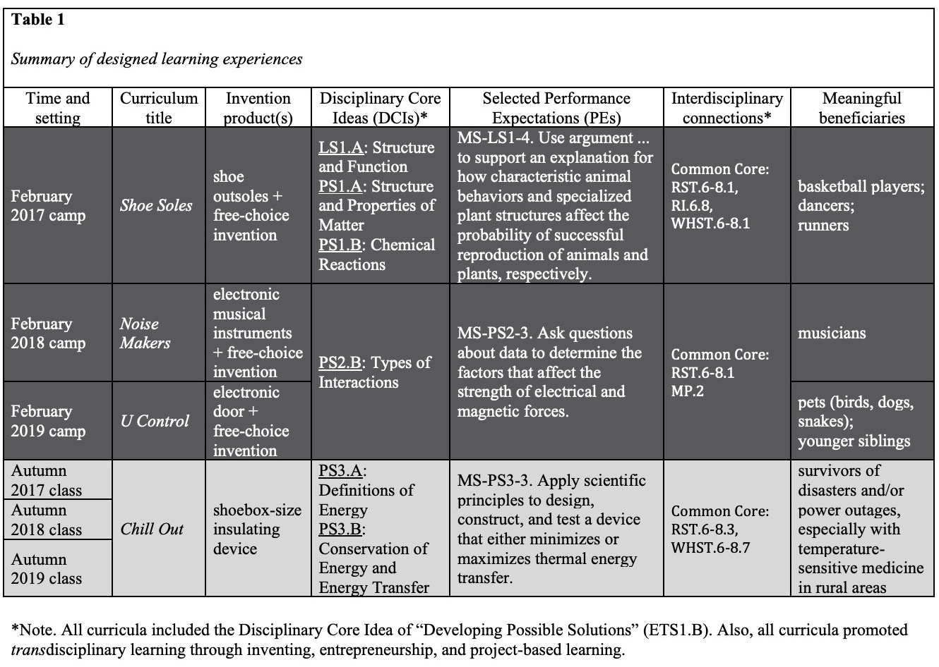

Slide 43
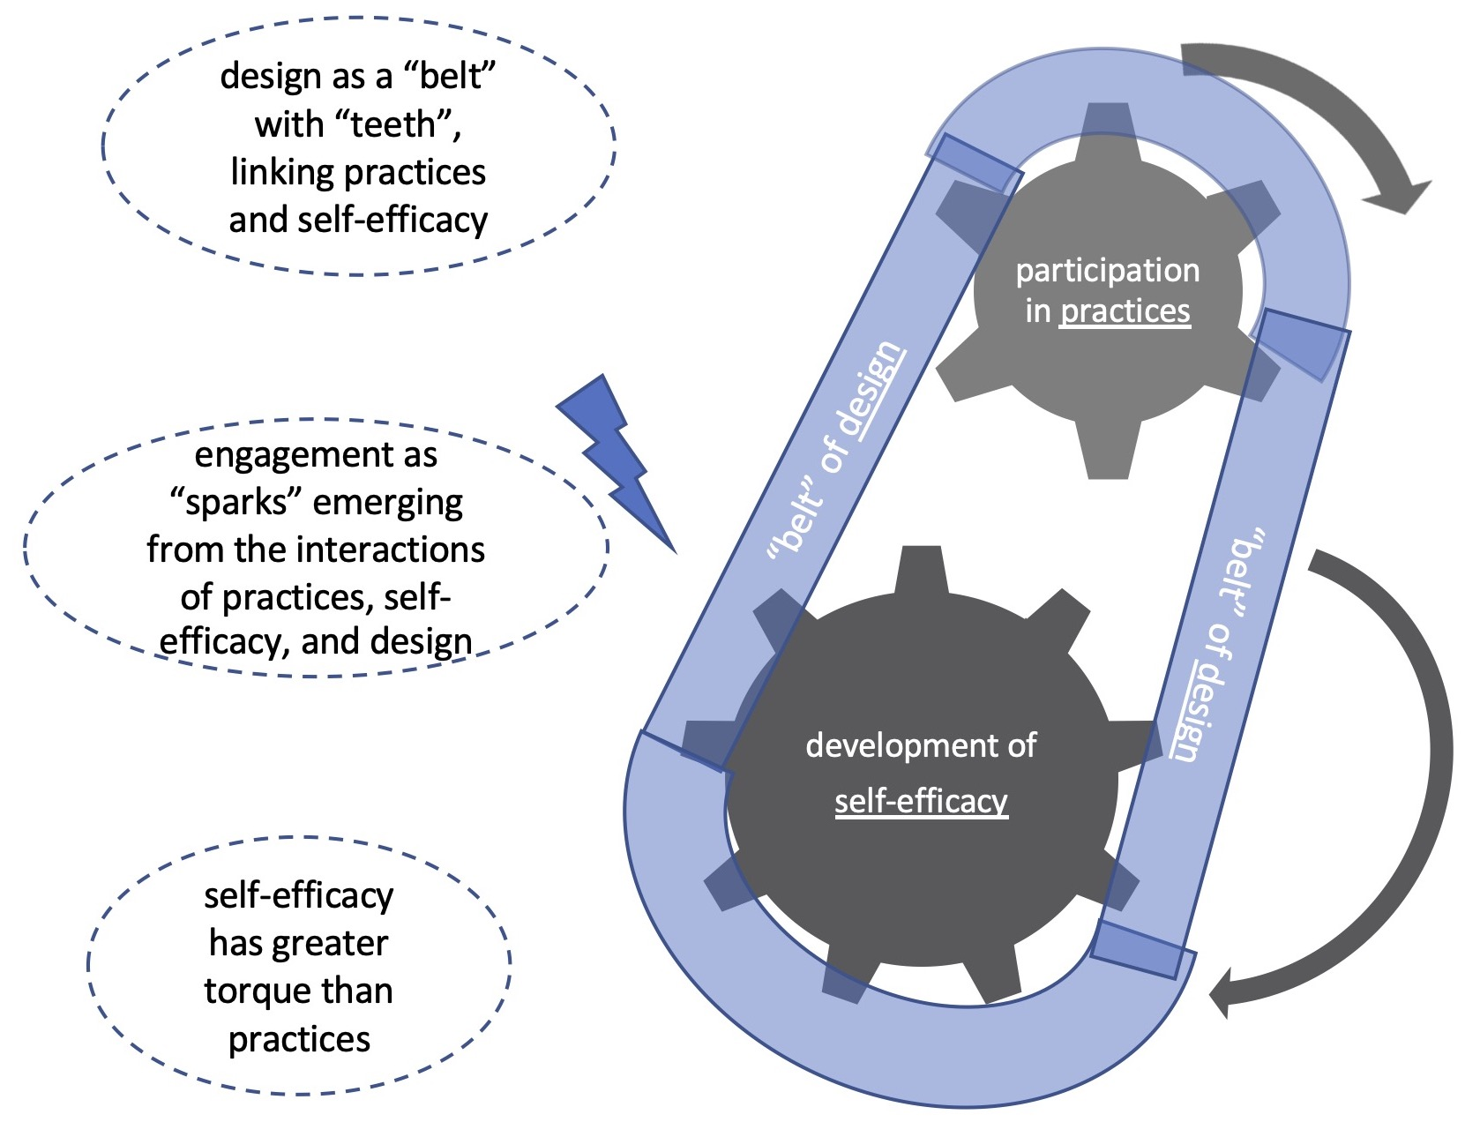

Slide 44
